Slide 1

Unity.scene Flow Diagram
ModeSelect
Loading
Store
MatchRoom
Landing
Main Menu
Profile
Loading
Loading
Loading
Tutorial
Gameplay
Scenes on the critical path
Loading
Scenes on the critical path and heavy photon use.
Secondary Scenes
EndGame
Transitional Scenes

Slide 2
PlayFab Component Overview
Unity Scene | PlayFab Features Used | Implementation Notes
Landing | AndroidDevicePushNotificationRegistration LoginWithFacebook GetTitleNews (For random interstitial tips) LoadTitleData (For a dynamic string table) UpdateUserTitleDisplayName GetUserCombinedInfo GetUserStatistics | Instantiates the Account Manager containing the PlayFabManager.cs component, acting as the data access layer for the game. The account manager provides functionality through the game and persists across scenes. In the Landing scene, we show: How to authenticate Facebook tokens via the Facebook SDK How to load TitleData for a dynamic string table How to load TitleNews for random interstitial tips
Store | ValidateGooglePlayPurchase UpdateUserData GetUserInventory ConsumeItem | Instantiates OpenIABEventManager, which acts as our controller for our In-App purchase example. Here we are using the Open IAB plugin to access the Google Play API. After the IAB transaction has taken place, items are added to the player inventory after a successful validation. In this game, there is only one item to purchase, a 2nd character to play in the arena.
Profile | GetLeaderboard | Player kills stats compared to other players’.
Room | GetCatalogItems PurchaseItem ConsumeItem UpdateUserData (experince & level) UpdateUserStatistics (kills & wins) SendPushNotification | The major gameplay scene where PlayFab usage focuses around: An in game store where the player can buy upgrades and items. Saving stats such as kills & wins Update player data to track experience & level
Match

Slide 3
Key:
Persists Across Scenes
Photon Flow Overview
Prefab
Scene Object
ModeSelect
Photon use spans three main scenes.
PhotonInstantiator
PhotonManager
ModeSelect
Loading
PhotonInstantiator
MultiplayerRoomsManager
MatchRoom
ModeSelectScene
Loading
Photon usage begins in the ModeSelect scene
The scene opens with the loading spinner, while this screen is up several assets are loaded in the background.
Awake(): the PhotonInstantiator instantiates the PhotonManager into the scene.
Start(): the ModeSelectScene initializes the MultiplayerRoomsManager by opening the connection to the Photon MasterServer and providing a callback for OnPhotonConnected.
OnPhotonConnected is called triggering the end of the loading spinner and activating the mode select buttons.
After the player chooses a game mode, ModeSelectScene attempts to join a random room (if exists) or create a new.
This triggers the loading spinner once more while the app awaits the OnJoinedRoomCallback.
OnJoinedRoomCallback then loads the next scene (“MatchRoom”)
Tutorial
Gameplay
Loading
EndGame

Slide 4
Key:
Scenes
Photon Flow Overview (continued)
Prefabs
Scene Objects
MatchRoom
MatchRoom / Gameplay
PhotonNetwork / SDK
EndGame
RoomScreenControls
PhotonManager
AI, Tower, Items, etc.
GameController
ChatManager
PhotonView
MatchRoomScreen
MultiplayerRoomsManager
Player
The scene opens and presents players with the options to select teams, characters, and chat among the other players. The MultiplayerRoomsManaer and RoomNetworkLayer classes handle most of the interfacing to and from the Photon SDK. However views and other scripts occasionally reference PhotonNetwork for convenience.
Start(): MatchRoomScreen connects the Chat channel, and sets up the needed callbacks.
The player chooses their character and clicks confirm
Confirm Sets the Photon player state to ready
Each ready call triggers the OnPropertiesChanged event. In handling this event, the master client determines that all players are ready which triggers StartGame() and ActivateLevel(), which fires the “OnNetworkActivate” RPC
OnNetworkStartGame gets called on all clients and each begins Instantiating their character and teammate GameObjects and network views.
MatchRoomScreen.OnStartGame() is triggered from the Callback and:
Exits the chatroom
Activates the matchScreen GameObjects
Deactivates the roomScreen GameObjects
Instantiates any needed AI players (bots)
various [RPC]
calls
PlayerNetworkLayer
PlayerManager
PhotonView
Gameplay primarily consists of synchronizing PhotonViews and their RPCs which are called through by the game controllers via network layers over the course of the game.
The game begins and eventually one team defeats the other team calling the final RPC call “OnNetworkGameEnded” bringing about the GameController clean-up, save data to PlayFab, and load the End Game scene.
For more information see:
Photon RPC List - Good for tracking down methods by name
Screenshots for more instructions on the gameplay rules.

Slide 5
Complete list of Photon RPC Calls
RPC Name | RPC Name (Cont.)
Chat ColorRpc DestroyRpc DoJump InstantiateRpc Marco NetworkEndGame NetworkResyncGame OnAwakeRPC OnNetworkBulletHit OnNetworkLevelChanged OnNetworkLifeChanged OnNetworkPlayerChanged OnNetworkPlayerJoined OnNetworkPlayerLeft OnNetworkShootBullet OnNetworkTowerShoot OnNetworkUpdateShield PickupItemInit Polo PunPickup PunPickupSimple PunRespawn RequestForPickupTimes TaggedPlayer InstantiateObject | OnNetworkTakeBullet OnNetworkRespawn OnViewIDAllocated OnNetworkCreateNewDrop OnNetworkCatchItem OnNetworkPropertiesChanged OnNetworkStartTimer OnNetworkActivateLevel OnNetworkGiveStatBonus OnGameEnded OnNetworkGameEnded OnNetworkCreateBots OnNetworkCreateBot OnNetworkInstantiateBot OnNetworkStopTimer

Slide 6
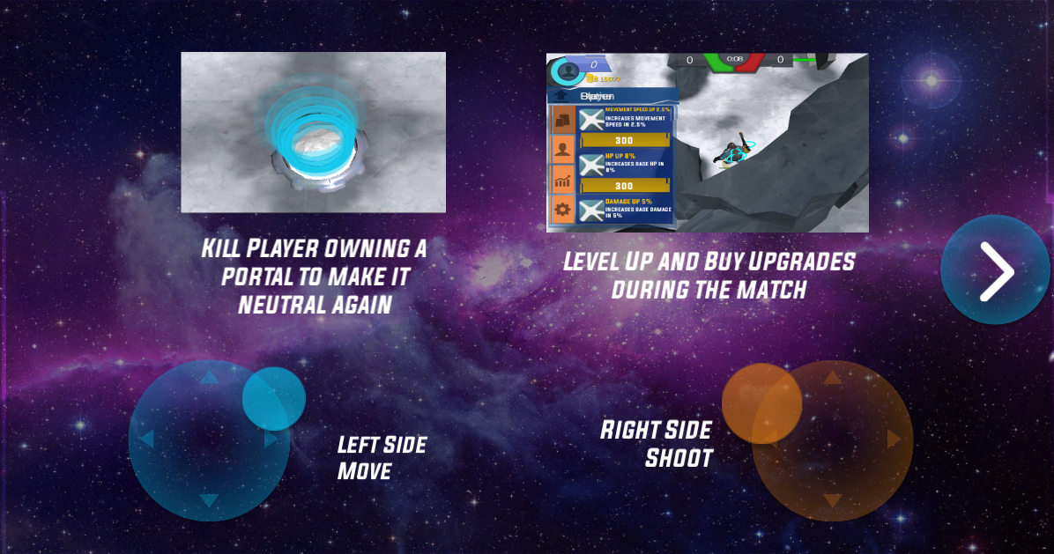
How to play (from the client)

Slide 7
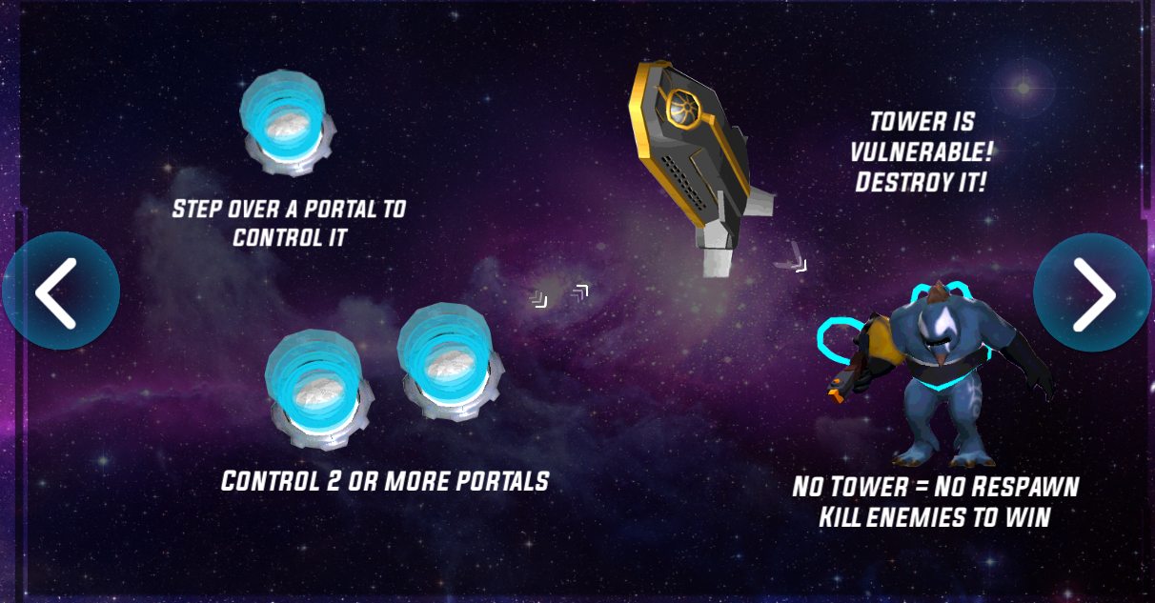
How to play (from the client) continued

